Slide 1
Integrating Medicaid & IHS Data
for American Indians & Alaska Natives
Data Project of the:
Centers for Medicare & Medicaid (CMS)
Tribal Technical Advisory Group (TTAG)

Slide 2
Medicaid has become a growing source of health care funding for IHS Direct Services, Contracting Tribes & their Health Programs:
But the IHS has very limited data on the Medicaid enrollment, health care and payments for IHS/Tribal Health Programs & the AI and AN who rely on them

Slide 3
2006 CMS AIAN Strategic Plan
Notes:
2006 CMS AIAN Strategic Plan
Recommended the Data Project
To assess what needs to be done to improve CMS AIAN data to integrate with IHS data (the gaps)
For program and policy analysis
To inform AIAN policy making
To recommend strategies to accomplish what needs to be done
To recommend a budget for implementation of strategies

Slide 4
Link IHS and Medicaid Data
IHS National Data Warehouse (IHS)
2004 - 2006
Medicaid national data (MAX)
2006
Medicaid Enrollee
data Linked to
IHS Active User list
Names of IHS Active Users, Medicaid enrollees &
health care providers were not identified

Slide 5
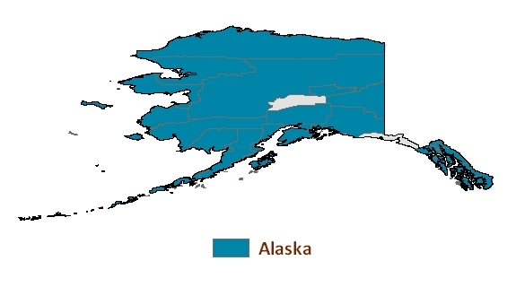
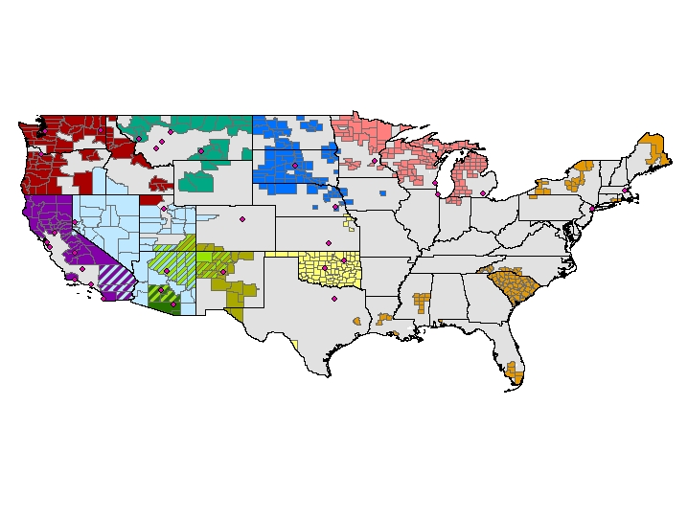
For12 IHS Regional Areas

Slide 6
Basic Questions Need Data
What proportion of IHS Active Users are enrolled in Medicaid?
How well does Medicaid data recognize IHS Active Users and their use of IHS & Tribal Health Programs?
How well is health care of IHS Active Users paid by Medicaid?
What proportion of AI and AN are Racially Misclassified in Medicaid data?
Notes:
2. Are all Medicaid IHS/Tribal Program users also IHS Active Users?
Do all IHS Active Users who are Medicaid enrollees have IHS or Tribal Health Program payments?

Slide 7
Question 1:
What fraction of IHS ‘Active Users’ are Enrolled in Medicaid? 37% overall
Notes:
Maximal Medicaid enrollment of Medicaid eligible IHS Active Users is important: Medicaid is a benefits entitlement program but the IHS is not. This means as the health care needs of a Medicaid enrollee increase, the number of eligible enrollees increase as with a recession, or as the costs of the care increase – Medicaid funding for its enrollees increase, but IHS funding does not.

Slide 8
Varies across the IHS Areas
Depends on:
How generous are Medicaid eligibility criteria in the states of each IHS Area
How well do the IHS Direct Service & Contracting Tribal populations meet those eligibility criteria
How generous is Medicaid health care coverage and payment in the states of each IHS Area
Notes:
2. Are all Medicaid IHS/Tribal Program users also IHS Active Users?
Do all IHS Active Users who are Medicaid enrollees have IHS or Tribal Health Program payments?

Slide 9
Percent of IHS Active Users Enrolled in Medicaid
Notes:
37% overall

Slide 10
Question 2: How well does Medicaid data recognize IHS Active Users & their use of IHS/Tribal Health Programs?
(1) What proportion of Medicaid enrollees who are Medicaid ‘IHS Program Users’ are also IHS ‘Active Users’? 70%

Slide 11
Medicaid 2 groups x IHS 2 groups = 4 groups
70%
30%

Slide 12
Medicaid ‘IHS Program Users’
Depends on:
How state Medicaid programs use information to determine which claims are IHS Program service claims for IHS eligible AI & AN.
Different states use different methods
Tribal lists, or
IHS/Tribal provider lists, or
Lists from fiscal intermediaries who process claims from IHS/Tribal providers
Notes:
2. Are all Medicaid IHS/Tribal Program users also IHS Active Users?
The Issue: Not all the Medicaid IHS Program Users meet the federal IHS eligible criteria of IHS Active Users because
most state Medicaid programs differ in how they use information provided by tribes, Indian healthcare providers or special fiscal intermediaries who process claims from Indian healthcare providers to determine which claims are IHS Program service claims of IHS eligible AIAN.
The Finding: More than two-thirds (70%) of Medicaid IHS Program service users are also IHS Active Users, but 30% are not. Further attention is needed by federal and state Medicaid programs to see that the criteria by which the federal IHS and state Medicaid and CHIP programs identify AIAN and IHS Program service claims from among all the claims that the IHS Program providers file are as consistent as possible with IHS criteria. If IHS eligible AIAN were identified at enrollment, then this additional enrollment information would help to decrease this problem.

Slide 13
Question 2: How well does Medicaid data recognize IHS Active Users & their use of IHS/Tribal Health Programs?
(2) What proportion of IHS ‘Active Users’ with a Medicaid claim have a Medicaid ‘IHS Program’ claim? 52%

Slide 14
IHS ‘Active Users’
Of all IHS ‘Active Users’ with at least one paid Medicaid claim
52% had a Medicaid IHS Program claim
48% did not

Slide 15
Medicaid 2 groups x IHS 2 groups = 4 groups
52%
48%

Slide 16
‘IHS Active Users’
Medicaid IHS Program claims are for:
2006 only, but
‘2006 IHS Active Users’ by definition could have used IHS/Tribal Program only in 2004 or 2005
Notes:
Definitions of IHS Active User not the same as Medicaid IHS Program user.

Slide 17
Question 3: How well is health care of IHS Active Users paid by Medicaid? :
(1) How do Medicaid payments for health care of IHS ‘Active Users’ compare to payments for other AIAN? Lower

Slide 18
Medicaid Payment per Person

Slide 19
IHS Eligible AIAN
Medicaid IHS Program ‘users’ who are Not IHS Active Users are
13% of AIAN Medicaid enrollees
But 22% of AIAN Total Medicaid payments

Slide 20
Question 3: How well is health care of IHS Active Users paid by Medicaid?
(2) How do Medicaid payments for
Medicaid ‘IHS Program Users’
vary across IHS Areas?

Slide 21
Medicaid Payment per IHS Program user
*Adjusted for age, disability, sex,
4 AIAN groups;
** Supplemented by Private Insurance

Slide 22
Varies across the IHS Areas
Depends on the states of each IHS Area:
How broad is Medicaid coverage of services
How high is the Medicaid payment per service
How high is medical cost inflation
And
The differences in how sick the AI and AN are who are enrolled in Medicaid in the different IHS Areas

Slide 23
Percent of Medicaid Payments that goes to the IHS Programs

Slide 24
Varies across the IHS Areas
Depends on:
How broad are Medicaid services provided by the IHS & Tribal Programs
Hospital services
Contract Health Providers
How high is the Medicaid payment per service provided by IHS &Tribal Programs

Slide 25
Question 4:
What percent of American Indians & Alaska Natives are Racially Misclassified in Medicaid Data? 13%, and . . .

Slide 26
Percent of IHS Active Users not ‘AI’ or ’AN’ Race in Medicaid
Notes:
13% for all IHS Areas combined

Slide 27
Rolling out Health Reform
Medicaid Data Needs
Track enrollment of Medicaid eligible AIAN
Identify AIAN eligible for IHS Programs
Identify IHS Program services & payments
Identify AIAN Race to detect Racial Disparities in Medicaid covered care
Notes:
Increases with Medicaid expansions?
Decreases with Insurance Exchanges?

Slide 28
Additional Data Needs:
To address these concerns, the Data Project needs also to continue work on
-- Medicare data
-- Health Care Coverage data from the American Community Survey Data

Slide 29
Questions we should analyze?
Contact
carol.korenbrot@crihb.net
About the Data Project of the:
Centers for Medicare & Medicaid (CMS)
Tribal Technical Advisory Group (TTAG)

